Slide 1
Strategy Design Pattern
Strategy pattern defines a family of algorithms, encapsulate each one, and make them interchangeable. Strategy lets the algorithm vary independently from clients that use it.
The main feature of this pattern is that the client have a set of algorithms in which a specific algorithm will be selected for use during runtime. This algorithms are interchangeable between them.
Also Known As Policy.
@ShankaragoudaG

Slide 2
Strategy Design Pattern
Test the performance of different sorting algorithms to an array of numbers: shell sort, heap sort, bubble sort, quicksort, etc.
Applying the Strategy pattern to these algorithms allows the test program to loop through all algorithms, simply by changing them at runtime and test each of these against the array.
For Strategy to work all method signatures must be the same so that they can vary without the client program knowing about it.
In JavaScript the Strategy pattern is widely used as a plug-in mechanism when building extensible frameworks.

Slide 3
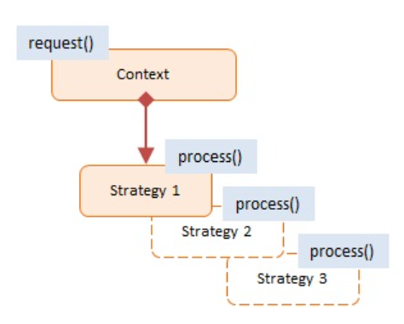
Diagram
Context
maintains a reference to the current Strategy object
supports interface to allow clients to request Strategy calculations
allows clients to change Strategy
Strategy
implements the algorithm
using the Strategy interface

Slide 4
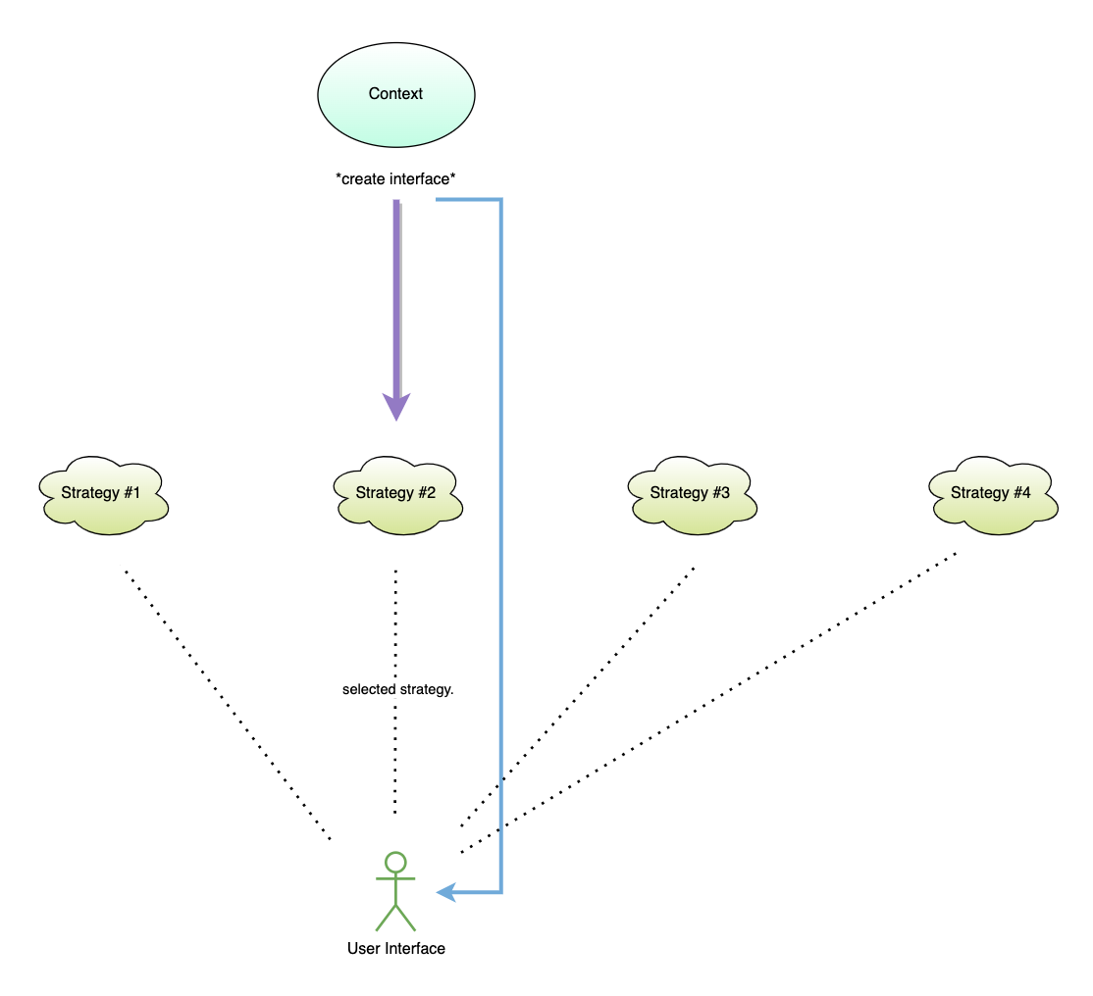
Flow

Slide 5
Example
Shipping is the Context and the 3 shipping companies UPS, USPS, and Fedex are the Strategies.
The shipping companies (strategies) are changed 3 times and each time we calculate the cost of shipping.
In a real-world scenario the calculate methods may call into the shipper's Web service.
At the end we display the different costs.

Slide 6
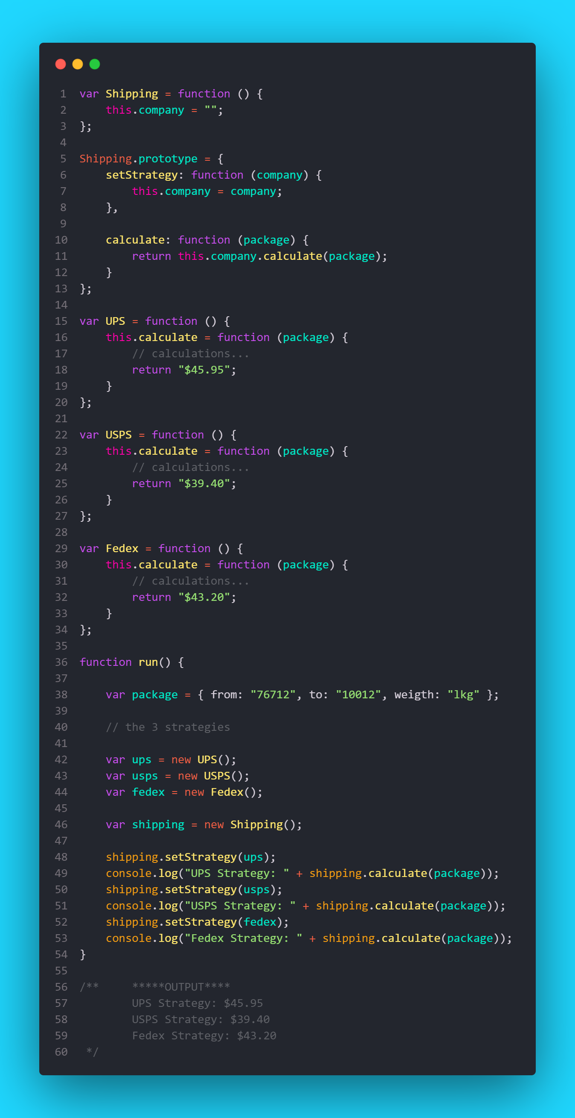

Slide 7
Useful Resources
https://carloscaballero.io/stategy-pattern-in-javascript-typescript/
https://jsmanifest.com/power-of-strategy-design-pattern-in-javascript/
https://robdodson.me/posts/javascript-design-patterns-strategy/#contrived-example-time!
https://www.dofactory.com/javascript/design-patterns/strategy

